Slide 1
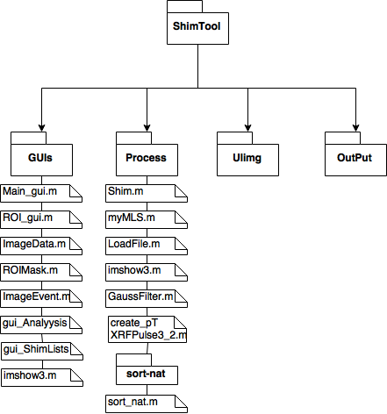
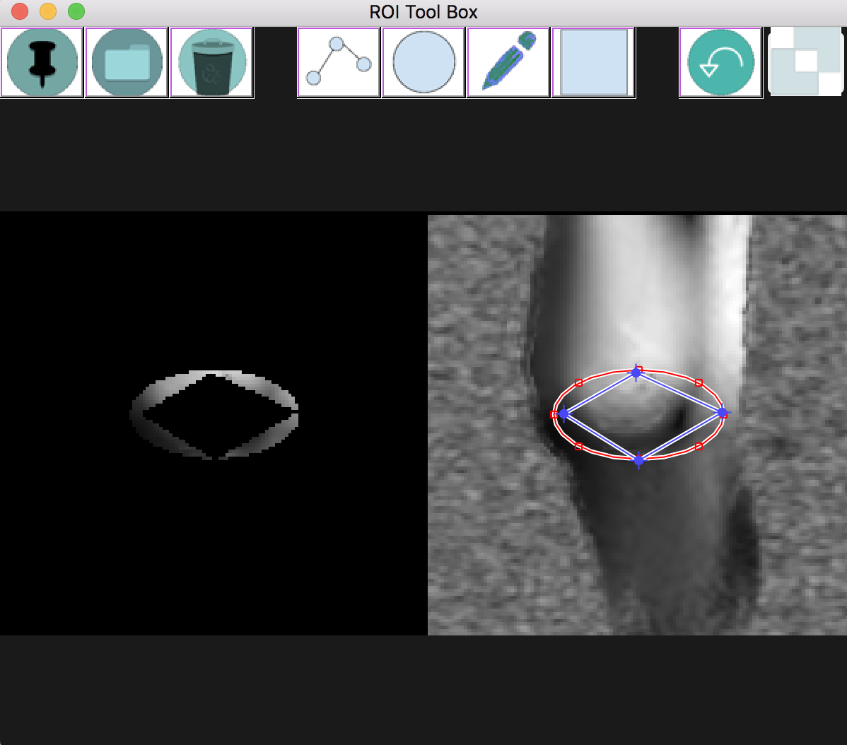
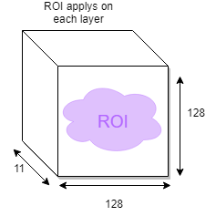
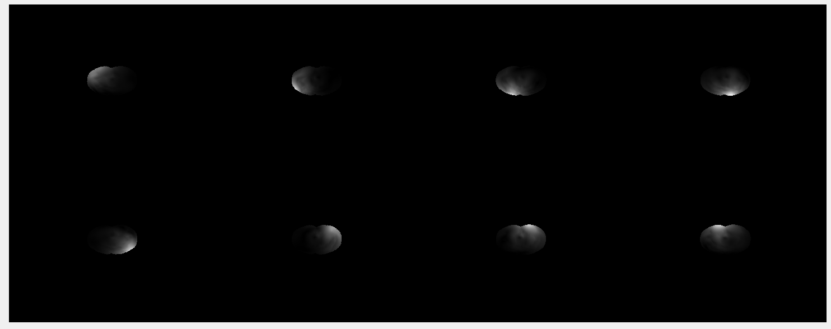
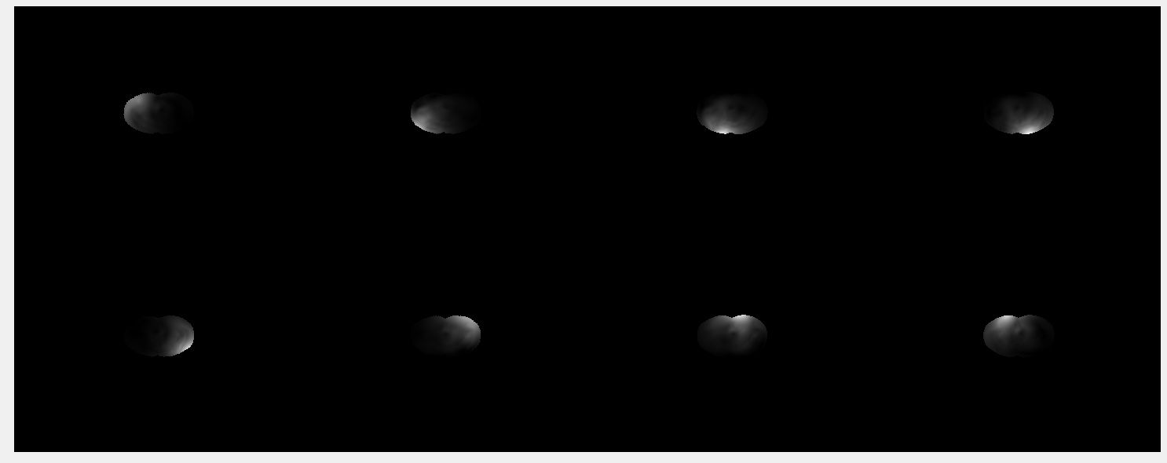
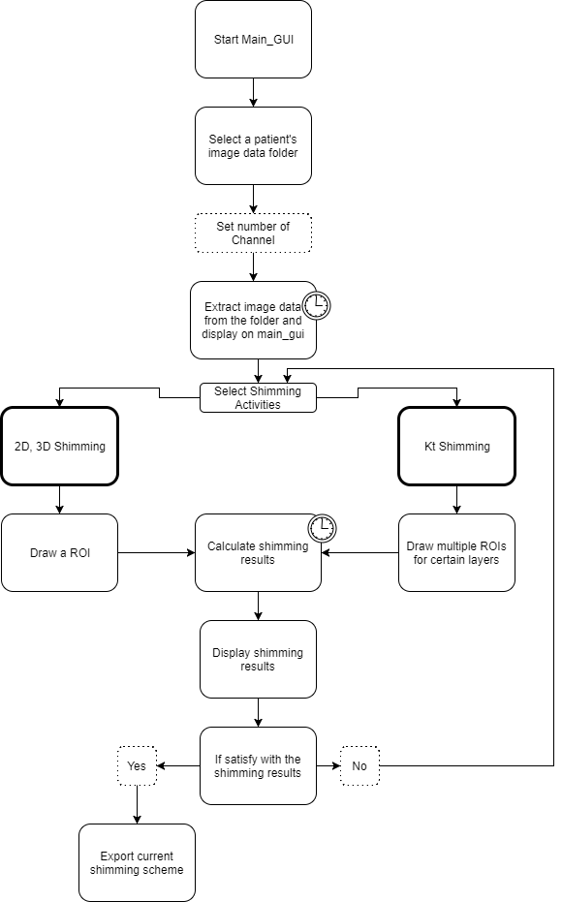
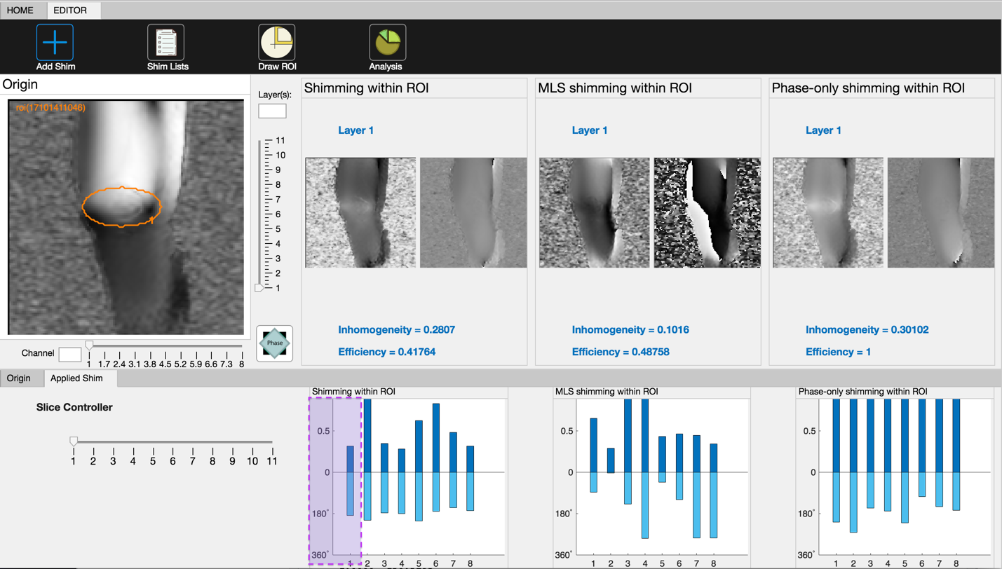
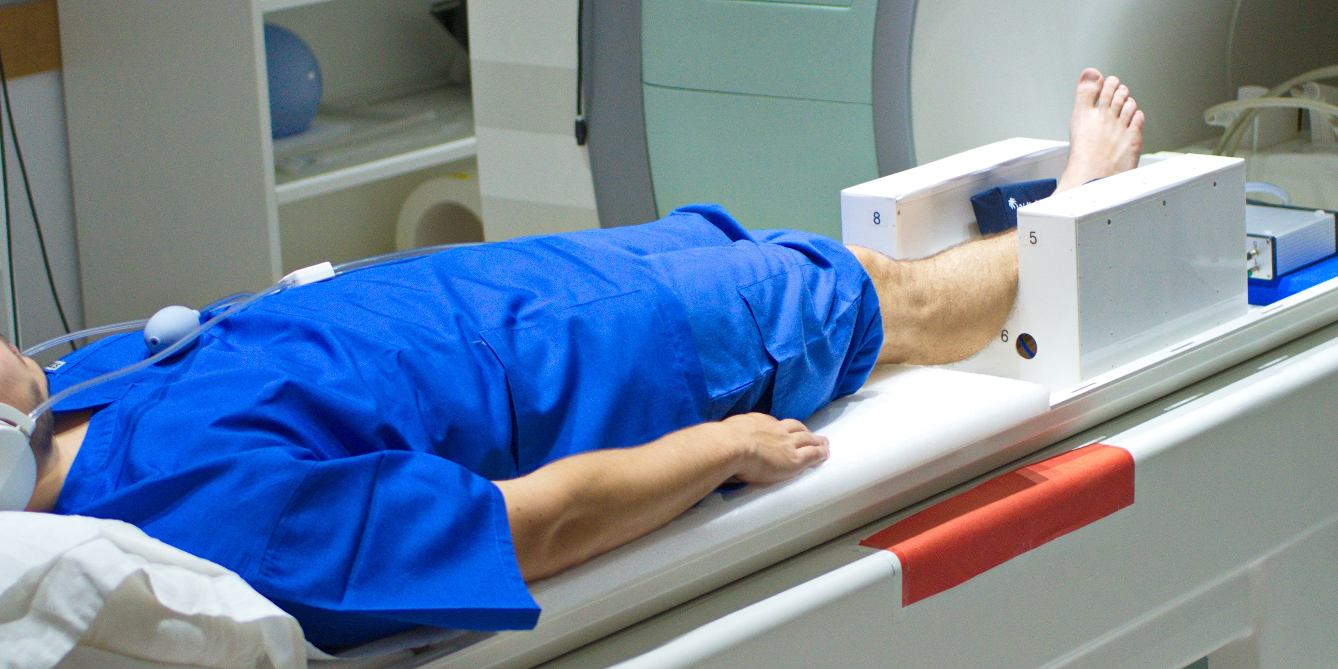
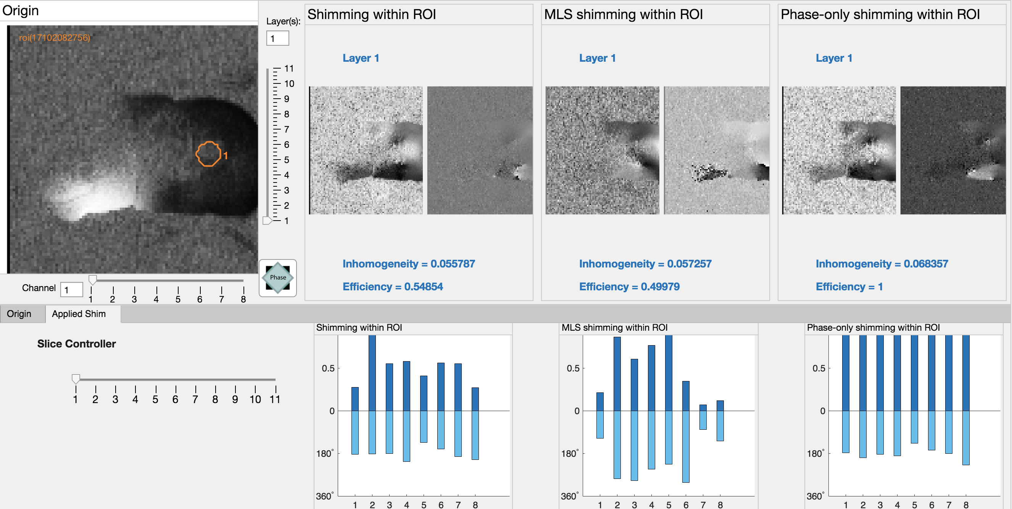
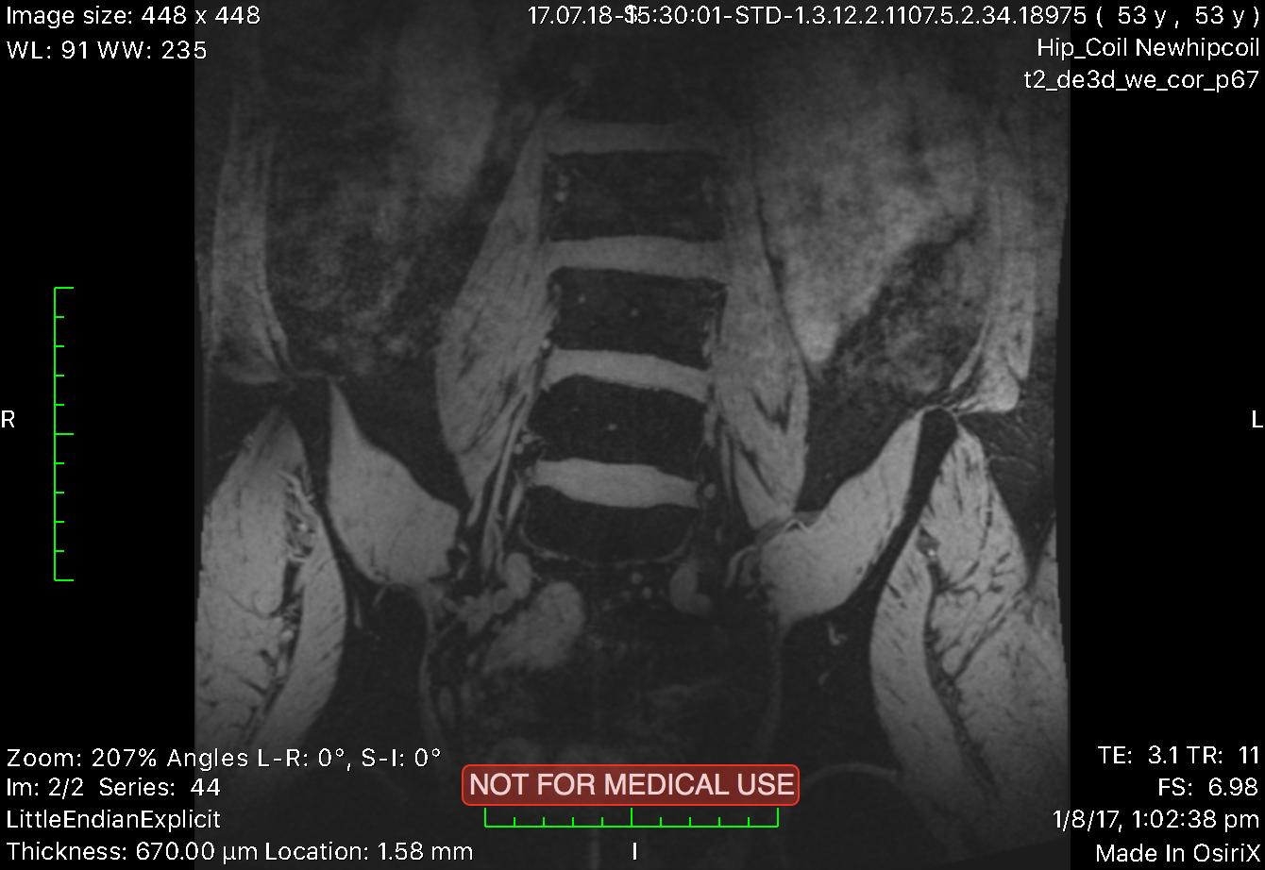
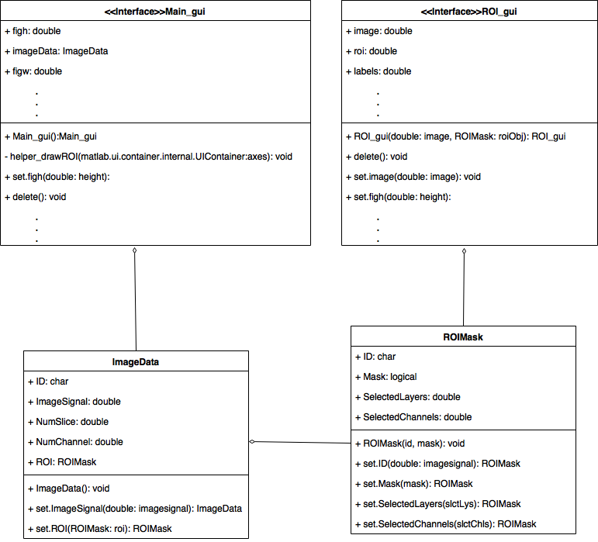
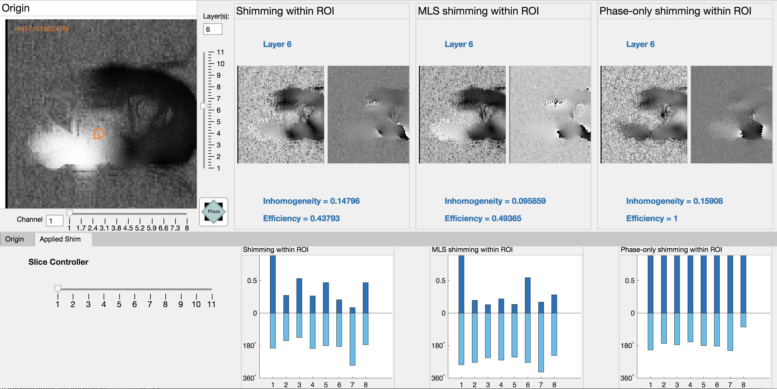
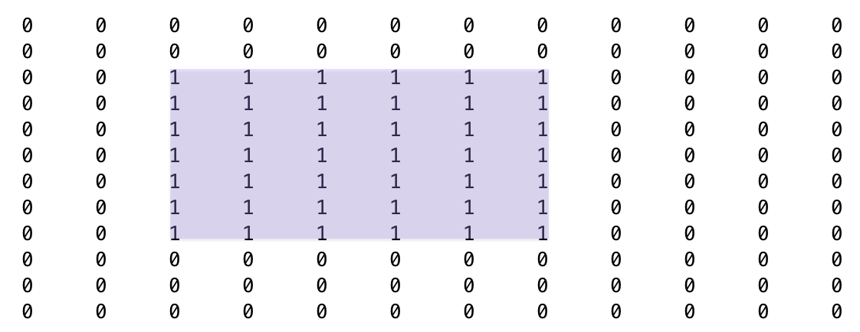
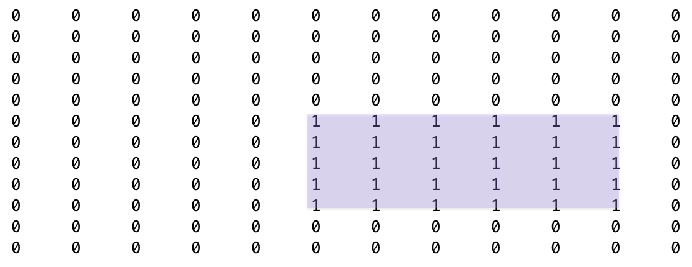
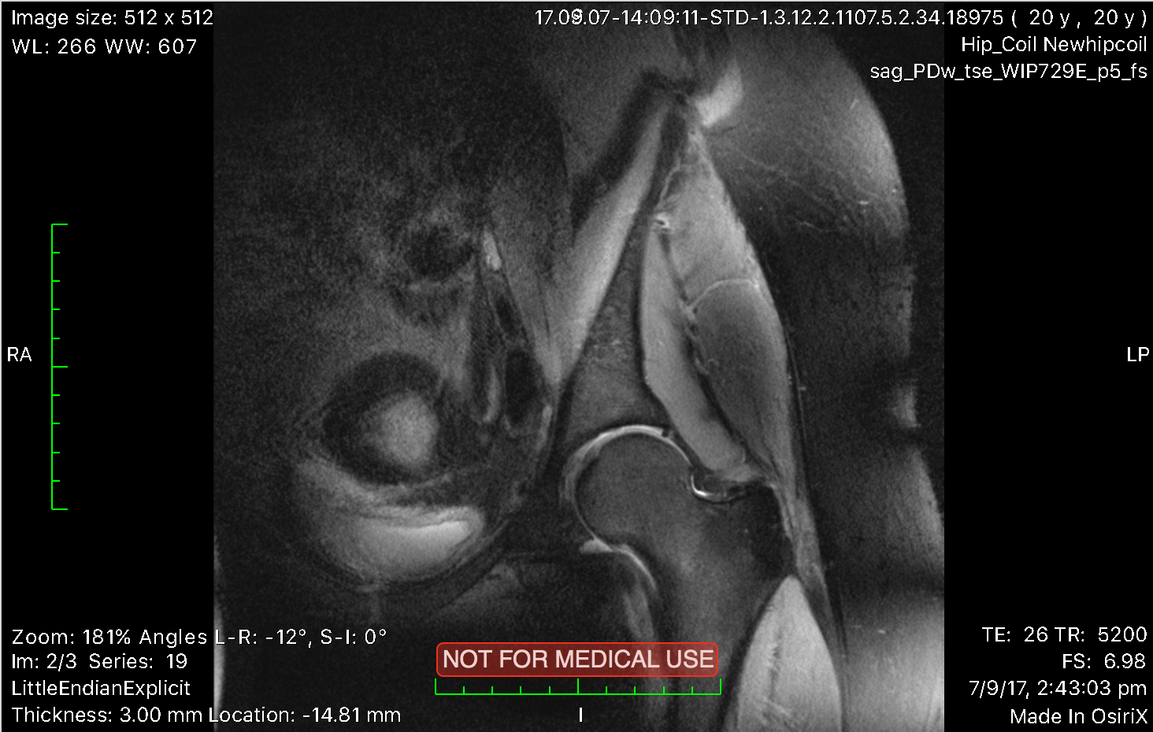


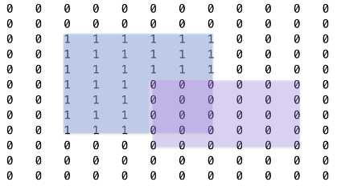
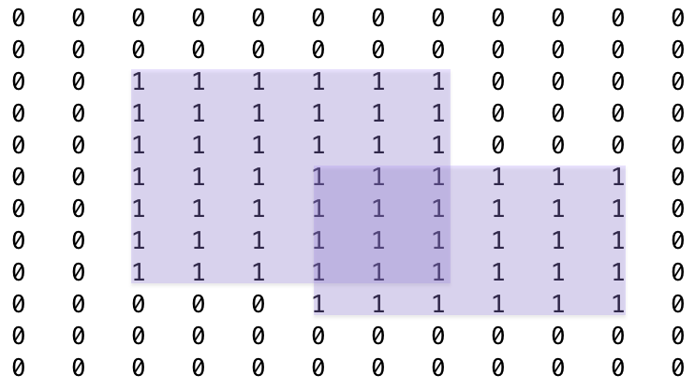


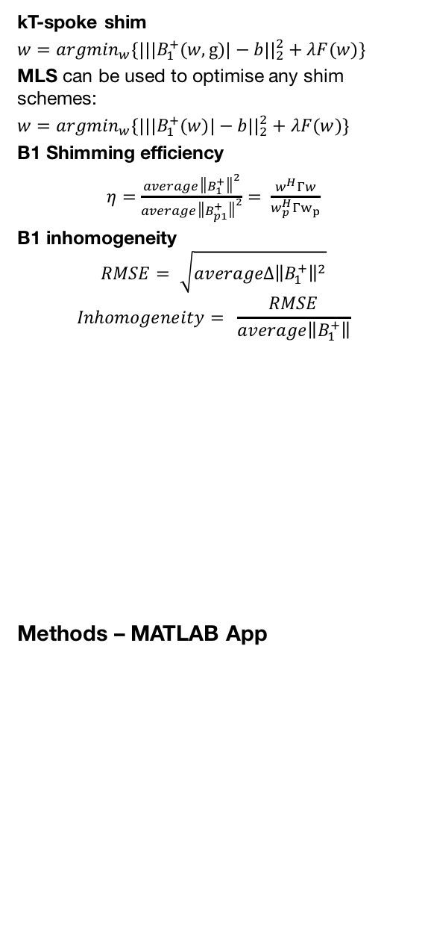
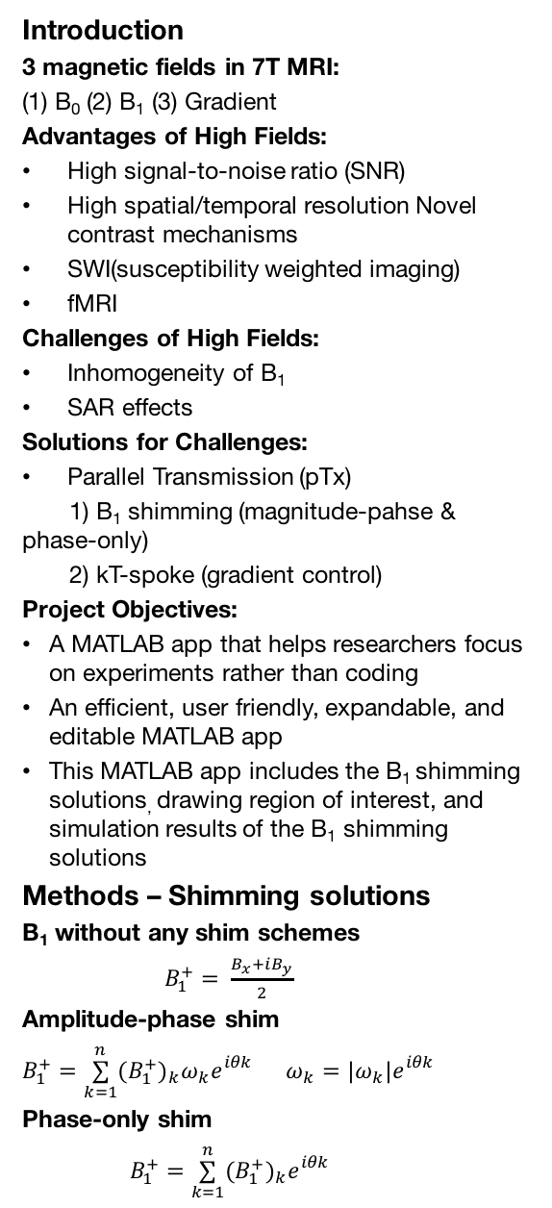
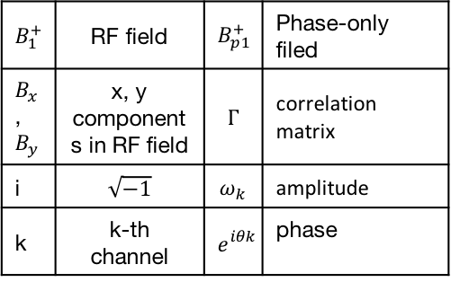
pTx pulse design FOR 7T MRI
Yangyang Xu & Dr.Jin Jin
Introduction
3 magnetic fields in 7T MRI:
(1) B₀ (2) B₁ (3) Gradient
Advantages of High Fields:
High signal-to-noise ratio (SNR)
High spatial/temporal resolution Novel contrast mechanisms
SWI(susceptibility weighted imaging)
fMRI
Challenges of High Fields:
Inhomogeneity of B₁
SAR effects
Solutions for Challenges:
Parallel Transmission (pTx)
1) B₁ shimming (magnitude-pahse & phase-only)
2) kT-spoke (gradient control)
Project Objectives:
A MATLAB app that helps researchers focus on experiments rather than coding
An efficient, user friendly, expandable, and editable MATLAB app
This MATLAB app includes the B₁ shimming solutions, drawing region of interest, and simulation results of the B₁ shimming solutions
Methods – Shimming solutions
B₁ without any shim schemes
$B_{1}^{+}= \frac{B_{x}+iB_{y}}{2}$
Amplitude-phase shim
$B_{1}^{+}=\overset{n}{\underset{k=1}{∑}}(B_{1}^{+})_{k}ω_{k}e_{}^{iθk}$ $ω_{k}=|ω_{k}|e_{}^{iθk}$
Phase-only shim
$B_{1}^{+}=\overset{n}{\underset{k=1}{∑}}(B_{1}^{+})_{k}e_{}^{iθk}$
kT-spoke shim
$w=argmin_{w}\{|||B_{1}^{+}(w,g)|−b||_{2}^{2}+λF(w)\}$
MLS can be used to optimise any shim schemes:
$w=argmin_{w}\{|||B_{1}^{+}(w)|−b||_{2}^{2}+λF(w)\}$
B1 Shimming efficiency
$η=\frac{average{\left\|B_{1}^{+}\right\|}^{2}}{average{\left\|B_{p1}^{+}\right\|}^{2}}= \frac{w^{H}Γw}{w_{p}^{H}Γw_{p}}$
B1 inhomogeneity
$$RMSE= \sqrt{average∆{\left\|B_{1}^{+}\right\|}^{2}}$$
$$Inhomogeneity= \frac{RMSE}{average\left\|B_{1}^{+}\right\|}$$
Methods – MATLAB App
Results
Conclusion:
Small ROIs can achieve better efficiency, but phase-only has the best efficiency. The MLS improves the homogeneity.
B_{x}
B_{y}
Bilateral Hip
Knee
$$B_{1}^{+}$$ | RF field | $$B_{p1}^{+}$$ | Phase-only filed
$B_{x}$, $B_{y}$ | x, y components in RF field | $$Γ$$ | correlation matrix
i | $\sqrt{−1}$ | $$ω_{k}$$ | amplitude
k | k-th channel | $$e_{}^{iθk}$$ | phase
Lumbar Spine
Unilateral Hip
A
B
A&~B
A|B

